Slide 1
CREATE AND CONFIGURE VIRTUAL MACHINE SETTINGS AND STORAGE

Slide 2
Objective
Create and configure virtual machine settings
Virtualization architectures
Hyper-V implementations
Installing Hyper-V
Using Hyper-V Manager
Configuring resource metering
Create and configure virtual machine storage
Virtual disk formats
Creating virtual disks
Configuring pass-through disks
Modifying virtual disks
Creating checkpoints
Configuring Storage Quality of Service (QoS)
Connecting to a storage area network (SAN)

Slide 3
Create and configure virtual machine settings

Slide 4
Virtualization architectures
Virtualization products can use several different architectures to share a computer’s hardware resources among VMs.
The earlier type of virtualization products, including Microsoft Windows Virtual PC and Microsoft Virtual Server, requires a standard OS installed on a computer. This becomes the “host” OS.
Then you install the virtualization product, which adds the hypervisor component.
The hypervisor essentially runs alongside the host OS, as shown in Figure, and enables you to create as many VMs as the computer has hardware to support.

Slide 5
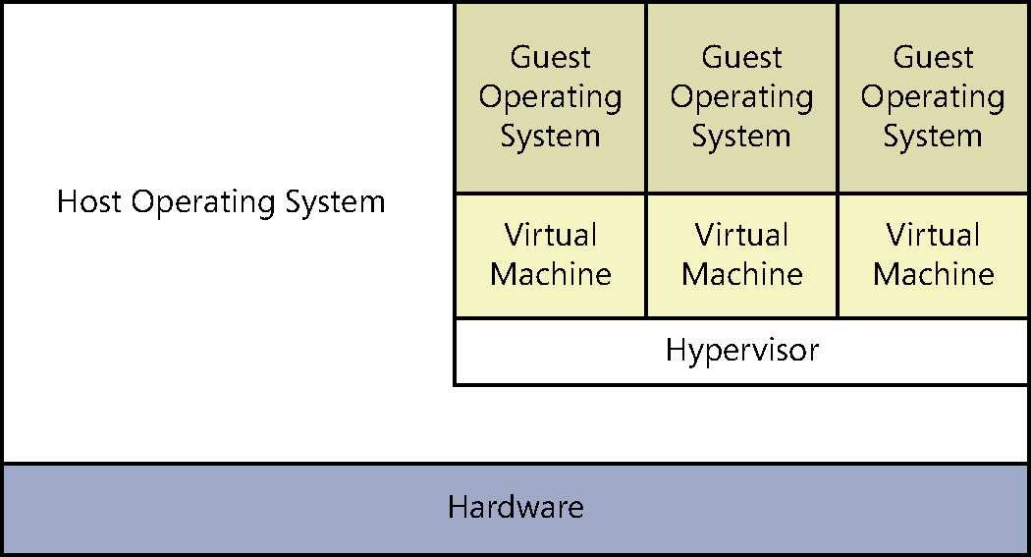
Virtualization architectures (Contd.,)
Fig: A hybrid VMM sharing hardware access with a host operating system

Slide 6
Virtualization architectures (Contd.,)
This arrangement, in which the hypervisor runs on top of a host OS, is called Type II virtualization.
By using the Type II hypervisor, you create a virtual hardware environment for each VM.
You can specify how much memory to allocate to each VM, create virtual disk drives by using space on the computer’s physical drives, and provide access to peripheral devices.
You then install a “guest” OS on each VM, just as if you were deploying a new computer.
The host OS then shares access to the computer’s processor with the hypervisor, with each taking the clock cycles it needs and passing control of the processor back to the other.

Slide 7
Virtualization architectures (Contd.,)
Type II virtualization can provide adequate VM performance, particularly in classroom and laboratory environments, but it does not provide performance equivalent to separate physical computers.
Therefore, it is not generally recommended for high-traffic servers in production environments.

Slide 8
Virtualization architectures (Contd.,)
The virtualization capability built into Windows Server 2012 R2, called Hyper-V, uses a different type of architecture.
Hyper-V uses Type I virtualization, in which the hypervisor is an abstraction layer that interacts directly with the computer’s physical hardware—that is, without an intervening host OS.
The term hypervisor is intended to represent the level beyond the term supervisor, in regard to the responsibility for allocating a computer’s processor clock cycles.

Slide 9
Virtualization architectures (Contd.,)
The hypervisor creates individual environments called partitions, each of which has its own OS installed and accesses the computer’s hardware via the hypervisor.
Unlike Type II virtualization, no host OS shares processor time with the hypervisor.
Instead, the hypervisor designates the first partition it creates as the parent partition and all subsequent partitions as child partitions, as shown in Figure.

Slide 10
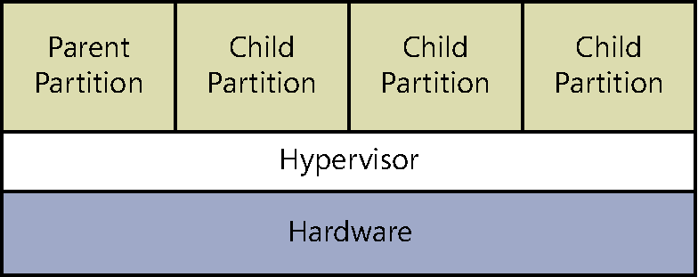
Virtualization architectures (Contd.,)
Fig: A Type I VMM, with the hypervisor running directly on the hardware

Slide 11
Virtualization architectures (Contd.,)
The parent partition accesses the system hardware through the hypervisor, just as the child partitions do.
The only difference is that the parent runs the virtualization stack, which creates and manages the child partitions.
The parent partition is also responsible for the subsystems that directly affect the performance of the computer’s physical hardware, such as Plug and Play, power management, and error handling.
These subsystems also run in the OSs on the child partitions, but they address only virtual hardware, whereas the parent, or root, partition handles the actual hardware.

Slide 12
Hyper-V implementations
Hyper-V licensing
Hyper-V hardware limitations
Hyper-V Server
Notes:
HYPER-V
It might not seem like the Hyper-V role in Windows Server 2012 R2 provides Type I virtualization,
because it requires the Windows Server OS to be installed and running. However,
adding the Hyper-V role actually converts the installed instance of Windows Server 2012
R2 into the parent partition and causes the system to load the hypervisor before the OS.

Slide 13
Hyper-V implementations
Windows Server 2012 R2 includes the Hyper-V role only in the Standard and Datacenter editions.
The Hyper-V role is required for the OS to function as a computer’s primary partition, enabling it to host other VMs.
No special software is required for an OS to function as a guest OS in a VM.
Therefore, although Windows Server 2012 R2 Essentials does not include the Hyper-V role, it can function as a guest OS.
Other guest OSs supported by Hyper-V include the current Windows workstation OSs and many other non-Microsoft server and workstation products.

Slide 14
Hyper-V licensing
The primary difference between the Standard and Datacenter editions of Windows Server 2012 R2 is the number of VMs they support.
When you install a Windows Server 2012 R2 instance on a VM, you must have a license for it, just like when you install it on a physical machine.
Purchasing the Datacenter edition allows you to license an unlimited number of VMs running Windows Server 2012 R2 on that one physical machine.
The Standard license allows you to license only two virtual instances of Windows Server 2012 R2.

Slide 15
Hyper-V hardware limitations
The Windows Server 2012 R2 version of Hyper-V contains massive improvements in the scalability of the system over previous versions.
A Windows Server 2012 R2 Hyper-V host system can have up to 320 logical processors, supporting up to 2,048 virtual CPUs and up to 4 terabytes (TB) of physical memory.
One server can host as many as 1,024 active VMs and a single VM can have up to 64 virtual CPUs and up to 1 TB of memory.
Hyper-V can also support clusters with up to 64 nodes and 8,000 VMs.

Slide 16
Hyper-V Server
In addition to the Hyper-V implementation in Windows Server 2012 R2, Microsoft provides a dedicated Hyper-V Server product, which is a subset of Windows Server 2012 R2.
Hyper-V Server 2012 R2 includes the Hyper-V role, which it installs by default during the OS installation.
With the exception of some limited File and Storage Services and Remote Desktop capabilities, the OS includes no other roles, as shown in Figure.

Slide 17
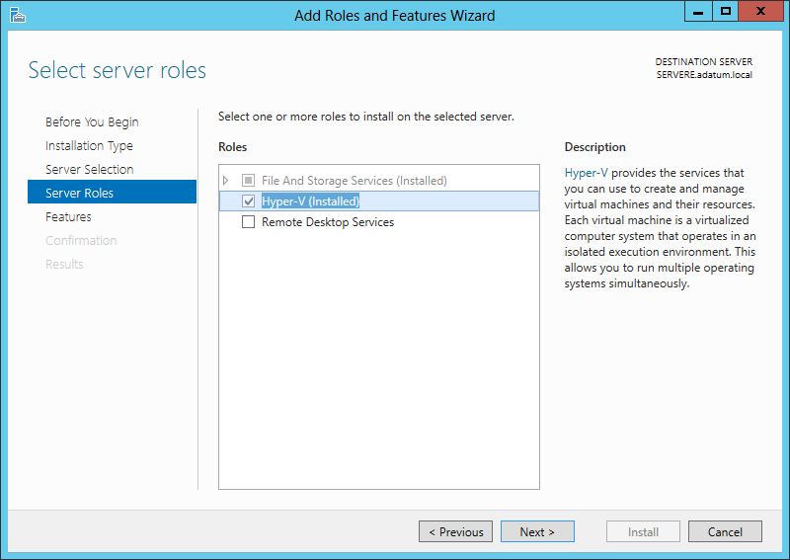
Hyper-V Server (Contd.,)
Fig: Roles available in Hyper-V Server

Slide 18
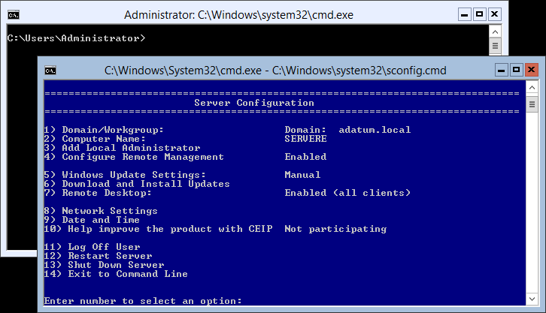
Hyper-V Server (Contd.,)
The Hyper-V Server is also limited to the Server Core interface, although as with all Server Core installations it includes SCONFIG, a simple, script-based configuration interface, as shown in Figure.
You can manage Hyper-V Server remotely by using Server Manager and Hyper-V Manager, just as you would any other Server Core installation.
Fig: The Server Core interface in Hyper-V Server
Notes:
Unlike Windows Server 2012 R2, Hyper-V Server is a free product, available for download
from Microsoft’s website. However, Hyper-V Server does not include any licenses for virtual
instances. You must obtain and license all the OSs you install on the VMs you create.

Slide 19
Installing Hyper-V
Once you have the appropriate hardware, you can add the Hyper-V role to Windows Server 2012 R2 by using Server Manager, just as you would any other role.
Adding the Hyper-V role installs the hypervisor software, and, in the case of a full GUI installation, also installs the management tools.
The primary tool for creating and managing VMs and their components on Hyper-V servers is the Hyper-V Manager console.
Hyper-V Manager provides administrators with a list of all the VMs on the local host and enables administrators to configure the environments of both the servers and the individual VMs.
There is also a set of Hyper-V cmdlets for Windows PowerShell that enables you to exercise complete control over VMs using that interface.

Slide 20
Installing Hyper-V (Contd.,)
Before you can install the Hyper-V role on a server running Windows Server 2012 R2, you must have the appropriate hardware:
A 64-bit processor that includes hardware-assisted virtualization. This is available in processors that include a virtualization option, such as Intel Virtualization Technology (Intel VT) or AMD Virtualization (AMD-V) technology.
A system BIOS that supports the virtualization hardware, on which the virtualization feature has been enabled.
Hardware-enforced Data Execution Prevention (DEP), which Intel describes as eXecute Disable (XD) and AMD describes as No eXecute (NX). This is a technology used in CPUs to segregate areas of memory. Specifically, you must enable the Intel XD bit (execute disable bit) or the AMD NX bit (no execute bit).

Slide 21
Installing Hyper-V (Contd.,)
To install the Hyper-V role, use the following procedure.
1. In Server Manager, on the Manage menu, select Add Roles And Features. The Add Roles And Features Wizard starts, displaying the Before You Begin page.
2. Click Next to open the Select Installation Type page.
3. Leave the Role-Based Or Feature-Based Installation option selected and click Next. The Select Destination Server page opens.
4. Select the server on which you want to install Hyper-V and click Next. The Select Server Roles page opens.

Slide 22
Installing Hyper-V (Contd.,)
5. Select the Hyper-V role. The Add Features That Are Required For Hyper-V dialog box appears.
6. Click Add Features to accept the dependencies and then click Next to open the SelectFeatures page.
7. Click Next to open the Hyper-V page.
8. Click Next. The Create Virtual Switches page opens, as shown in Figure.

Slide 23
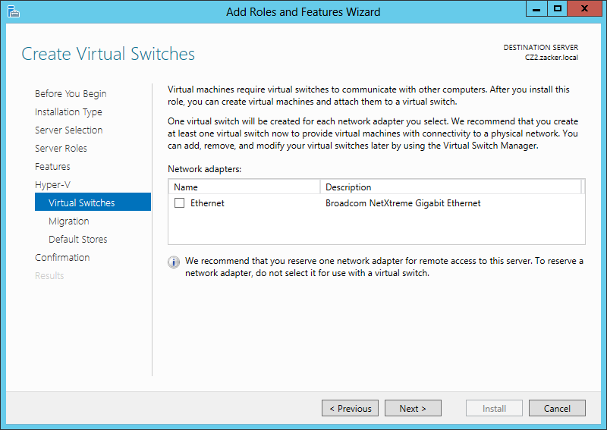
Installing Hyper-V (Contd.,)
Fig: The Create Virtual Switches page of the Add Roles and Features Wizard

Slide 24
Installing Hyper-V (Contd.,)
9. Select the appropriate check box for a network adapter and click Next. The Virtual Machine Migration page opens, as shown in Figure.
10. Click Next to open the Default Stores page.

Slide 25
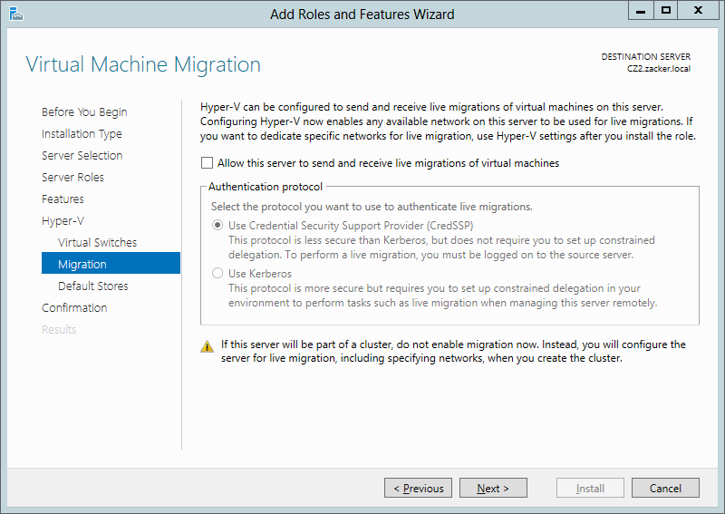
Installing Hyper-V (Contd.,)
Fig: The Virtual Machine Migration page of the Add Roles and Features Wizard

Slide 26
Installing Hyper-V (Contd.,)
11. Specify alternatives to the default locations for virtual hard disk (VHD) and VM configuration files, if desired, and click Next. The Confirm Installation Selection page opens.
12. Click Install to move to the Installation Progress page as the wizard installs the role.
13. Click Close to close the wizard.
14. Restart the server.

Slide 27
Using Hyper-V Manager
Creating a virtual machine
Creating Generation 1 and Generation 2 VMs
Installing an operating system
Configuring Guest Integration Services

Slide 28
Using Hyper-V Manager
Once you have installed the Hyper-V role and restarted the computer, you can begin to create VMs and deploy OSs on them by using the Hyper-V Manager console, which you can access from the Tools menu in Server Manager.
Like most of the Windows Server 2012 R2 management tools, including Server Manager itself, you can use the Hyper-V Manager.
To run Hyper-V Manager on a server that does not have the Hyper-V role, you must install the Hyper-V Management Tools feature.
These tools are also found in the Remote Server Administration Tools feature
Notes:
you can use the Hyper-V Manager console to create and manage VMs on multiple servers, enabling administrators to exercise full control over their servers from a central location.

Slide 29
Using Hyper-V Manager (Contd.,)
Once you install and launch the Hyper-V Manager console, you can add servers to the display by right-clicking the Hyper-V Manager node in the left pane and selecting Connect
To Server from the shortcut menu. The Select Computer dialog box appears, in which you can type or browse to the name of a Hyper-V server.
The Hyper-V Manager console lists all the VMs on the selected server, as shown in Figure, along with status information about each one.

Slide 30
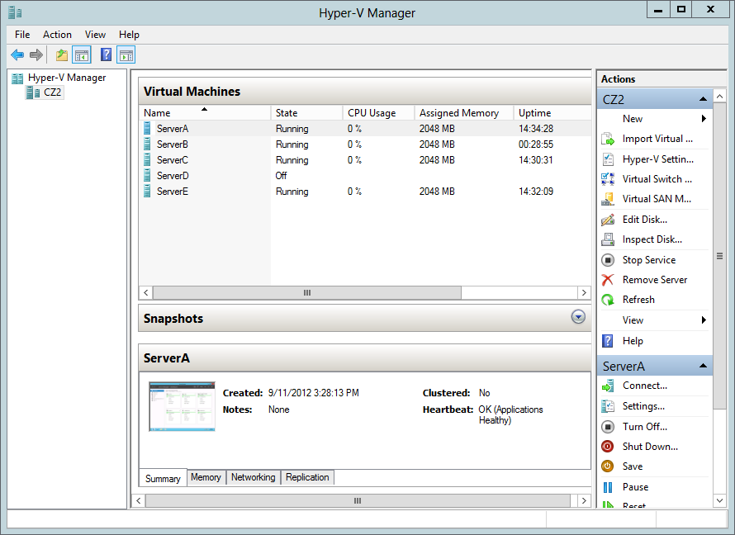
Using Hyper-V Manager (Contd.,)
Fig: The Hyper-V Manager console

Slide 31
Creating a virtual machine
After installing Hyper-V and configuring it using Hyper-V Manager, you are ready to create VMs and install the OS on each one.
By using Hyper-V Manager, you can create new VMs and define the hardware resources that the system should allocate to them.
In the settings for a particular VM, depending on the physical hardware available in the computer and the limitations of the guest OS, administrators can specify the number of processors and the amount of memory allotted to a VM, install virtual network adapters, and create virtual disks by using a variety of technologies, including storage area networks (SANs).

Slide 32
Creating Generation 1 and Generation 2 VMs
In Windows Server 2012 R2, Hyper-V includes a new type of virtual machine, which it refers to as Generation 2.
The VM type created by all previous versions is called Generation 1.
When you create a new virtual machine in the Hyper-V manager, the New Virtual Machine Wizard includes a new page on which you specify whether you want to create a Generation 1 or Generation 2 VM.
The New-VM cmdlet in Windows PowerShell also includes a new –Generation parameter.

Slide 33
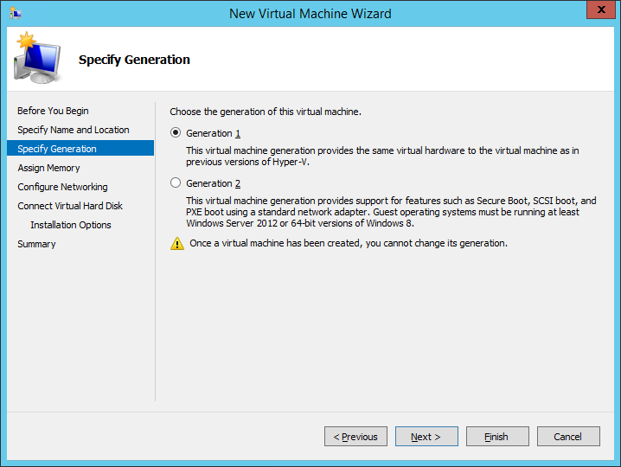
Creating Generation 1 and Generation 2 VMs (Contd.,)
Fig: The Specify Generation page in the New Virtual Machine Wizard

Slide 34
Configuring Guest Integration Services
In some cases, certain Hyper-V guest OS features do not function properly using the OS’s own device drivers.
Hyper-V, therefore, includes a software package called Guest Integration Services, which you can install on your VMs for compatibility purposes.
Some of the functions provided by the Guest Integration Services package are as follows:
Operating System Shutdown Enables the Hyper-V Manager console to remotely shut down a guest OS in a controlled manner, eliminating the need for an administrator to log on and manually shut the system down.
Time Synchronization Enables Hyper-V to synchronize the OS clocks in parent and child partitions.

Slide 35
Configuring Guest Integration Services (Contd.,)
Data Exchange Enables the Windows OSs on the parent and child partitions to exchange information, such as OS version information and fully qualified domain names.
Heartbeat Implements a service in which the parent partition sends regular heartbeat signals to the child partitions, which are expected to respond in kind. A failure of a child partition to respond indicates that the guest OS has frozen or malfunctioned.
Backup Enables backup of Windows VMs by using Volume Shadow Copy Services.
Guest Services Enables administrators to copy files to a virtual machine without using a network connection.

Slide 36
Configuring resource metering

Slide 37
Configuring resource metering
Resource metering is a Windows PowerShell–based feature in Windows Server 2012 R2 Hyper-V that enables administrators to document VM usage by using a variety of criteria.
There are various reasons why organizations might want to track the use of VMs.
For large corporations, it might be a matter of internal accounting and controlling ongoing expenses, such as wide area network (WAN) bandwidth.
For service providers, it might be necessary to bill customers based on the VM resources they use.

Slide 38
Configuring resource metering (Contd.,)
Resource metering uses Windows PowerShell cmdlets to track a variety of performance metrics for individual VMs, including the following:
CPU utilization
Minimum, maximum, and average memory utilization
Disk space utilization
Incoming and outgoing network traffic
Resource metering statistics remain consistent, even when you transfer VMs between host systems by using Live Migration or move VHD files between VMs.

Slide 39
Configuring resource metering (Contd.,)
To use resource metering, you must first enable it for the specific VM that you want to monitor by using the Enable-VMResourceMetering cmdlet with the following syntax:
Enable-VMResourceMetering –VMName <name>
Once you have enabled metering, you can display a statistical report at any time by using the Measure-VM cmdlet with the following syntax:
Measure-VM –VMName <name>

Slide 40
Create and configure virtual machine storage

Slide 41
Virtual disk formats
Windows Server 2012 R2 Hyper-V supports the original VHD disk image file and the new VHDX format.
The original VHD format was created by a company called Connectix for its Virtual PC product.
Microsoft later acquired the product and used the VHD format for all its subsequent virtualization products, including Hyper-V.
There are three types of VHD files, as follows:

Slide 42
Virtual disk formats (Contd.,)
Fixed hard disk image An image file of a specified size in which all the disk space required to create the image is allocated during its creation.
Dynamic hard disk image An image file with a specified maximum size, which starts small and expands as needed to accommodate the data the system writes to it.
Differencing hard disk image A child image file associated with a specific parent image. The system writes all changes made to the data on the parent image file to the child image, to manage disk space or to facilitate a rollback at a later time.

Slide 43
Virtual disk formats (Contd.,)
VHD images are limited to maximum size of 2 TB and are compatible with all versions of Hyper-V and Microsoft Type II hypervisor products, such as Virtual Server and Virtual PC.
Windows Server 2012 introduced an updated version of the format, which uses a VHDX filename extension.
VHDX image files can be as large as 64 TB, and they also support 4-KB logical sector sizes to provide compatibility with new 4-KB native drives.
VHDX files can also use larger block sizes (up to 256 MB), which enable administrators to fine-tune the performance level of a virtual storage subsystem to accommodate specific applications and data file types.

Slide 44
Creating virtual disks
Windows Server 2012 R2 Hyper-V provides several ways to create virtual disk files.
You can create them as part of a VM or create them at another time and add them to a VM.
The graphical interface in Hyper-V Manager provides access to most of the VHD parameters, but the Windows PowerShell cmdlets included in Windows Server 2012 R2 provide the most granular control over the disk image format.

Slide 45
Creating a virtual disk with a VM
The New Virtual Machine Wizard includes a Connect Virtual Hard Disk page with which you can add a single disk to your new VM. The options for this disk are relatively limited and consist of the following:
Create A Virtual Hard Disk Enables you to specify the name, location, and size of a new VHD. The wizard only allows you to create a dynamically expanding disk using the VHDX format, but you can also create fixed and differencing VHDX disks using Windows PowerShell.

Slide 46
Creating a virtual disk with a VM (Contd.,)
Use An Existing Virtual Hard Disk Enables you to specify the location of an existing VHD or VHDX disk, which the VM will presumably use as its system disk.
Attach A Virtual Hard Disk Later Prevents the wizard from adding any virtual disks to the VM configuration. The assumption is that you will manually add a disk later, before you start the VM.

Slide 47
Creating a new virtual disk
You can create a VHD file at any time without adding it to a VM by using the New Virtual Hard Disk Wizard in Hyper-V Manager. To create a new virtual disk, use the following procedure.
1. In Server Manager, on the Tools menu, select Hyper-V Manager. The Hyper-V Manager console opens.
2. In the left pane, select a Hyper-V server.
3. From the Action menu, select New, Hard Disk to start the New Virtual Hard Disk Wizard, displaying the Before You Begin page.
4. Click Next to open the Choose Disk Format page.
5. Select one of the following disk format options:
VHD Creates an image no larger than 2 TB, using the highly compatible VHD format
VHDX Creates an image up to 64 TB, using the new VHDX format

Slide 48
Creating a new virtual disk (Contd.,)
6. Click Next to open the Choose Disk Type page.
7. Select one of the following disk type options:
Fixed Size Creates a disk of a specific size, allocating all of the space at once
Dynamically Expanding Creates a disk that can grow to the maximum size you specify as you add data
Differencing Creates a child drive that will contain changes made to a specified parent drive
8. Click Next. The Specify Name And Location page opens.
9. Specify a file name for the disk image in the Name text box and, if desired, specify a location for the file other than the server default. Click Next to open the Configure Disk page.

Slide 49
Creating a new virtual disk (Contd.,)
10. For fixed and dynamically expanding disks, select and configure one of the following options:
Create A New Blank Virtual Hard Disk Specifies the size (or the maximum size) of the disk image file to create
Copy The Contents Of The Specified Physical Disk Enables you to select one of the physical hard disks in the computer and copy its contents to the new disk image
Copy The Contents Of The Specified Virtual Hard Disk Enables you to select an existing virtual disk file and copy its contents to the new disk image
11. Click Next. The Completing The New Virtual Hard Disk Wizard page opens.
12. Click Finish.
The wizard creates the new image disk and saves it to the specified location.

Slide 50
Adding virtual disks to virtual machines
Creating virtual disk image files as a separate process enables administrators to exercise more control over their capabilities, but after creating the VHD or VHDX files, you must add them to a VM for them to be useful.
To add a hard disk drive to a physical computer, you must connect it to a controller; the same is true with a VM in Hyper-V.
When you open the Settings dialog box for a Generation 1 VM in its default configuration, you see three controllers labeled IDE Controller 0, IDE controller 1, and SCSI Controller.
These correspond to the controllers you might find in a typical physical server computer.
To add an existing virtual system drive to a VM, use the following procedure.

Slide 51
Adding virtual disks to virtual machines (Contd.,)
1. In Server Manager, on the Tools menu, select Hyper-V Manager to open the Hyper-V Manager console.
2. In the left pane, select a Hyper-V server.
3. Select a VM and, in the Actions pane, select Settings. The Settings dialog box for the VM appears.
4. Select IDE Controller 0, as shown in Figure.

Slide 52
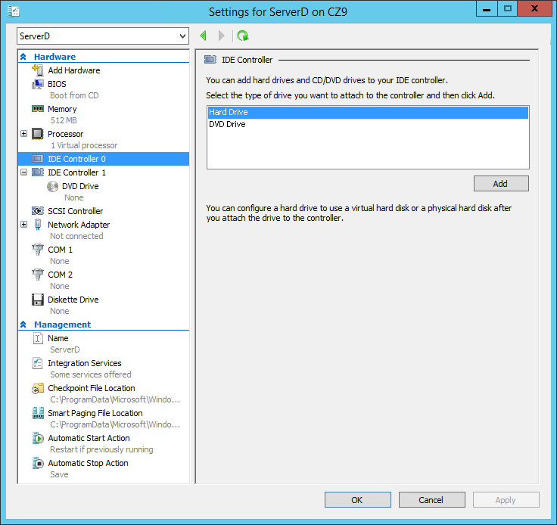
Fig: The IDE Controller interface in the Settings dialog box

Slide 53
Adding virtual disks to virtual machines (Contd.,)
5. In the IDE Controller box, select Hard Drive and click Add. The Hard Drive page opens, as shown in Figure.
6. In the Controller drop-down and the Location drop-down, select the IDE controller and the channel you want to use for the hard disk.
7. With the Virtual Hard Disk option selected, click Browse and select the disk image file you want to add.
8. Click OK to close the Settings dialog box.

Slide 54
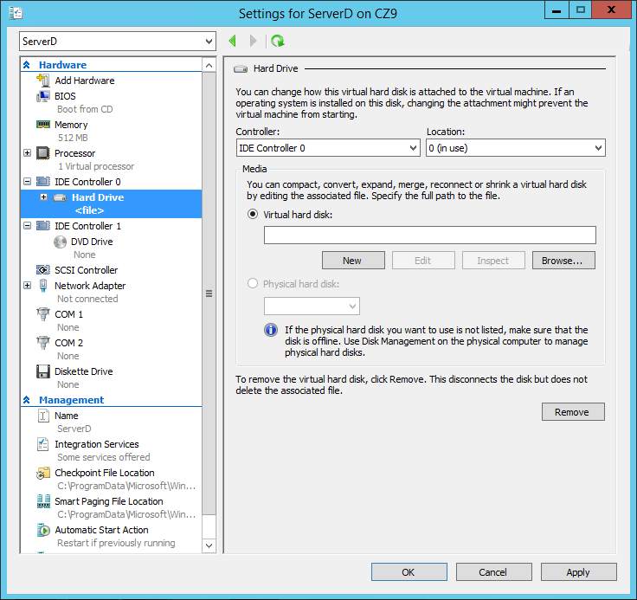
Fig: The Hard Drive interface in the Settings dialog box

Slide 55
Creating differencing disks
To create a cloned version of a baseline installation with a differencing disk, use the following procedure.
1. Install and configure the baseline VM Create a new VM with a new disk image file and install a guest OS on it. Configure the OS as needed and install any roles, features, applications, or services you need.
2. Generalize the parent image Open an elevated command prompt on the baseline system and run the Sysprep.exe utility with the appropriate parameters for your requirements. Sysprep configures the system to assign itself a new, unique securityID (SID) the next time the computer starts. This enables you to create multiple cloned systems from a single disk image.

Slide 56
Creating differencing disks (Contd.,)
3. Create a parent disk image Once you have generalized the baseline installation, you no longer need the original VM. You can delete everything except the VHD or VHDX file containing the disk image. This will become your parent image. Open the Properties sheet for the image file and set the read-only flag to ensure that the baseline does not change.
4. Create a differencing disk By using the New Virtual Hard Disk Wizard or the New- VHD cmdlet for Windows PowerShell, create a new differencing disk pointing to the baseline image you created and prepared earlier as the parent image.
5. Create a cloned VM Create a new VM and, on the Connect Virtual Hard Disk page, attach the differencing disk you just created to it by using the Use An Existing Virtual Hard Disk option.

Slide 57
Configuring pass-through disks
A pass-through disk is a type of virtual disk that points to a physical disk drive installed on the host computer.
When you add a hard drive to any of the controllers in a VM, you have the option of selecting a physical hard disk as opposed to a virtual one.
To add a physical hard disk to a VM, the VM must have exclusive access to it. This means that you must first take the disk offline in the parent OS by using the Disk Management snap-in, as shown in Figure, or the Diskpart.exe utility. Once the disk is offline, it will be available for selection in the Physical Hard Disk drop-down list

Slide 58
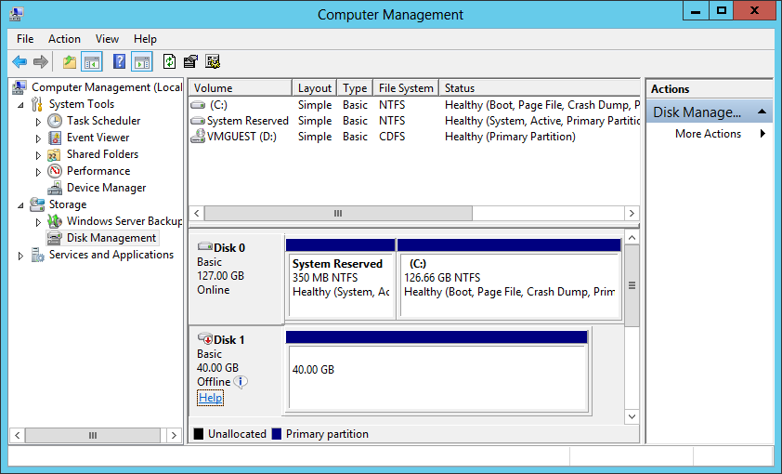
Fig: An offline disk in the Disk Management snap-in

Slide 59
Modifying virtual disks
Windows Server 2012 R2 and Hyper-V provide several ways for administrators to manage and manipulate VHD images without mounting them in a VM.
Once you have created a VHD, whether you have attached it to a VM or not, you can manage it by using the Edit Virtual Hard Disk Wizard in Hyper-V Manager.
To edit an existing VHD or VHDX file, use the following procedure.

Slide 60
Modifying virtual disks (Contd.,)
1. In Server Manager, on the Tools menu, select Hyper-V Manager to open the Hyper-V Manager console.
2. In the left pane, select a Hyper-V server.
3. In the Actions pane, select Edit Disk. The Edit Virtual Hard Disk Wizard starts, displaying the Before You Begin page.
4. Click Next to open the Locate Disk page.
5. Type or browse to the name of the VHD or VHDX file you want to open and click Next. The Choose Action page appears.

Slide 61
Modifying virtual disks (Contd.,)
6. Select one of the following functions:
Compact Reduces the size of a dynamically expanding or differencing disk by deleting empty space while leaving the disk’s capacity unchanged
Convert Changes the type of format of a disk by copying the data to a new disk image file
Expand Increases the capacity of the disk by adding empty storage space to the image file
Shrink Reduces the capacity of the disk by deleting empty storage space from the file
Merge Combines the data on a differencing disk with that of the parent disk to form a single composite image file
7. Click Next to open the Completing The Edit Virtual Hard Disk Wizard page.
8. Complete any new pages presented by the wizard as a result of your selection and click Finish.

Slide 62
Creating checkpoints
In Hyper-V, a checkpoint is a captured image of the state, data, and hardware configuration of a VM at a particular moment in time.
Creating checkpoints is a convenient way for administrators to revert a VM to a previous state at will.
Creating a checkpoint is as simple as selecting a running VM in Hyper-V Manager and selecting Checkpoint from the Actions pane.
The system creates a checkpoint file with an AVHD or AVHDX extension, in the same folder as the VHD file, and adds the checkpoint to the Hyper-V Manager display, as shown in Figure.
Notes:
AVHD- Automatic VHD

Slide 63
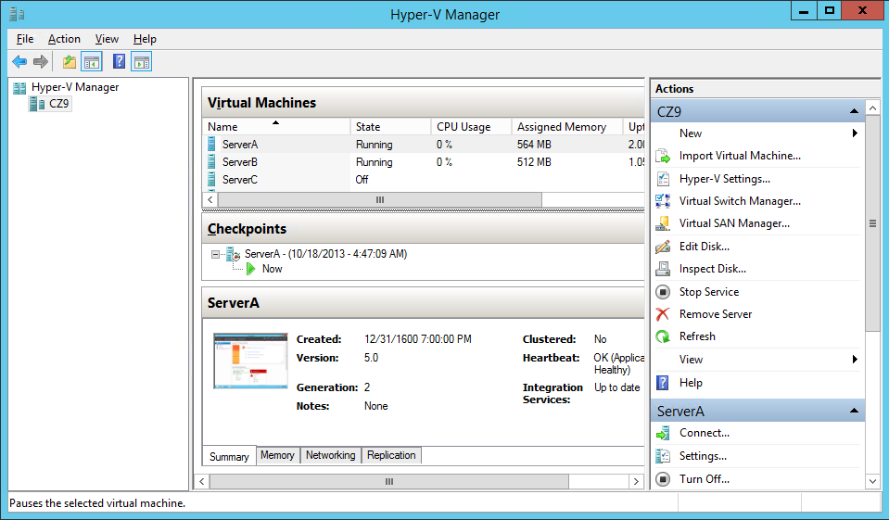
Fig: A checkpoint in Hyper-V Manager

Slide 64
Configuring Storage Quality of Service (QoS)

Slide 65
Configuring Storage Quality of Service (QoS)
It is common for there to be more than one virtual hard disk hosted by a single physical hard disk, it is possible for one virtual disk to monopolize the input/output capacity of a physical disk, causing the other virtual disks to slow down.
To help prevent this, Windows Server 2012 R2 enables you to control the Quality of Service (QoS) for a given virtual hard disk.
QoS management in Hyper-V takes the form of controls that enables you to specify the minimum and maximum input/output operations per second (IOPS) for a disk.
To configure storage QoS, open the Settings dialog box for a VM, expand a hard drive component, and select Advanced Features to display the Advanced Features page shown in Figure.

Slide 66
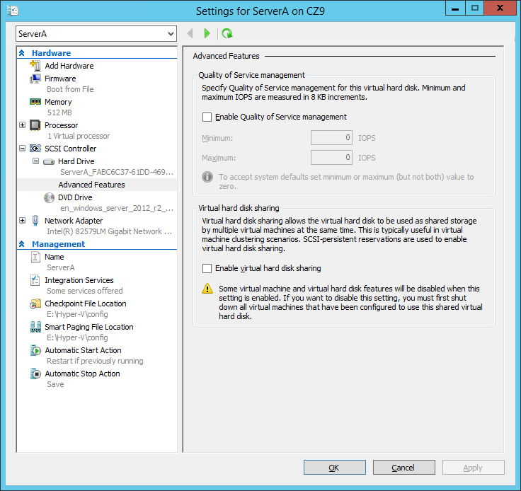
Fig: Storage Quality of Service controls in Hyper-V Manager

Slide 67
Connecting to a storage area network (SAN)
At its most basic level, a storage area network (SAN) is simply a network dedicated to high speed connections between servers and storage devices.
Instead of installing disk drives into servers or connecting them by using an external SCSI bus, a SAN consists of one or more drive arrays equipped with network interface adapters, which you connect to your servers by using standard twisted pair or fiber optic network cables.
A SAN-connected server, therefore, typically has at least two network adapters, one for the standard local area network (LAN) connection and one for the SAN, as shown in Figure.

Slide 68
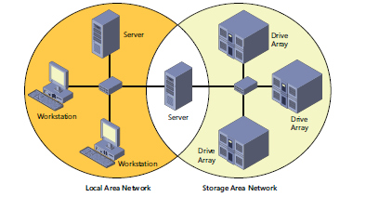
Connecting to a storage area network (SAN) (Contd.,)
Fig: A server connected to a SAN

Slide 69
Connecting to a storage area network (SAN) (Contd.,)
By connecting the storage devices to a network instead of to the servers themselves, you avoid the limitations imposed by the maximum number of devices you can connect directly to a computer.
SANs also provide added flexibility in their communications capabilities. Because any device on a SAN can conceivably communicate with any other device on the same SAN, high-speed data transfers can occur in any of the following ways:
Server to storage Servers can access storage devices over the SAN just as if they were connected directly to the computer.
Server to server Servers can use the SAN to communicate directly with one another at high speeds to avoid flooding the LAN with traffic.
Storage to storage Storage devices can communicate among themselves without server intervention, for example, to perform backups from one medium to another or to mirror drives on different arrays.

Slide 70
Connecting to a storage area network (SAN) (Contd.,)
Although a SAN is not in itself a high-availability technology, you can make it one by connecting redundant servers to the same network, as shown in Figure, enabling them to access the same data storage devices.
If one server should fail, another can assume its roles by accessing the same data. This is called server clustering.

Slide 71
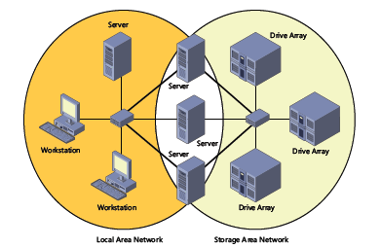
Connecting to a storage area network (SAN) (Contd.,)
Fig: Multiple servers connected to a SAN
Notes:
Servers and storage devices cannot exchange SCSI commands over a SAN connection the way they do when the devices are directly connected using a SCSI cable. To communicate over a SAN, servers and storage devices map their SCSI communications onto another protocol, such as Fibre Channel.

Slide 72
Using Fibre Channel
Fibre Channel is a versatile SAN communications technology supporting various network media, transmission speeds, topologies, and upper-level protocols. Its primary disadvantage is that it requires specialized hardware that can be extremely expensive.
Installing a traditional Fibre Channel SAN entails building an entirely new network with its own special medium, switches, and network interface adapters.
In addition to the hardware costs, which can easily be 10 times those of a traditional Ethernet network, there are also installation and maintenance expenses to consider.
Notes:
FIBRE CHANNEL
The nonstandard spelling of the word fibre in Fibre Channel is deliberate, to distinguish the
term from fiber optic. Fibre Channel can run on either twisted-pair copper cables or it can
run on optical cables, whereas the spelling fiber always refers to an optical medium.

Slide 73
Using Fibre Channel (Contd.,)
Fibre Channel is a rather esoteric technology, with relatively few experts in the field.
To install and maintain a Fibre Channel SAN, an organization must either hire experienced staff or train existing personnel on the new technology.
However, there is also a variant called Fibre Channel over Ethernet (FCoE) that uses standard Ethernet hardware and is therefore much less expensive.

Slide 74
Connecting virtual machines to a SAN
The specialized networking technologies used to build Fibre Channel SANs have, in the past, made it difficult to use them with virtualized servers.
However, since the Windows Server 2012 implementation, Hyper-V has supported the creation of virtual Fibre Channel adapters.
A Hyper-V Fibre Channel adapter is essentially a pass-through device that enables a VM to access a physical Fibre Channel adapter installed in the computer, and through that, to access the external resources connected to the SAN.
With this capability, applications running on VMs can access data files stored on SAN devices and administrators can use VMs to create server clusters with shared storage subsystems.

Slide 75
Connecting virtual machines to a SAN (Contd.,)
Assuming you have the appropriate hardware and software installed on the host computer, you implement the Fibre Channel capabilities in Hyper-V by first creating a virtual SAN by using the Virtual SAN Manager, accessible from Hyper-V Manager.
When you create the virtual SAN, the World Wide Node Names (WWNNs) and World Wide Port Names (WWPNs) of your host bus adapter appear, as shown in Figure.

Slide 76
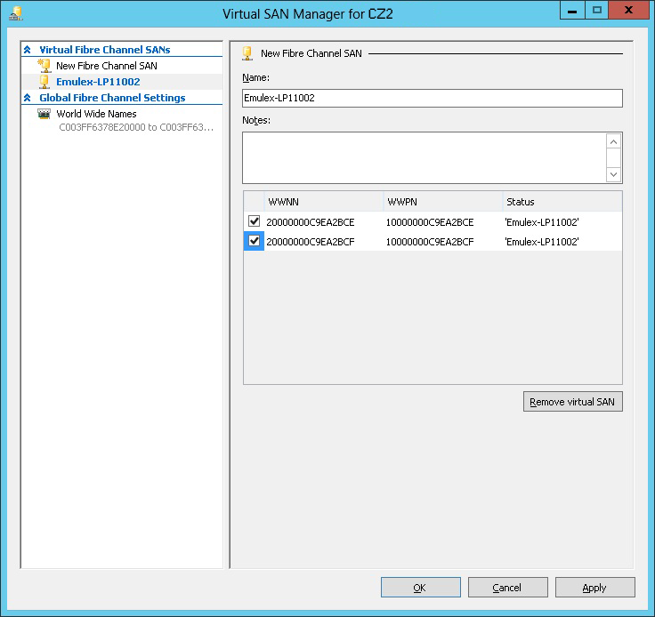
Fig: WWNNs and WWPNs in a virtual SAN

Slide 77
Connecting virtual machines to a SAN (Contd.,)
The next step is to add a Fibre Channel adapter to a VM from the Add Hardware page in the Settings dialog box.
When you do this, the virtual SAN you created earlier is available on the Fibre Channel Adapter page, shown in Figure.
Hyper-V virtualizes the SAN and makes the WWNNs and WWPNs available to the VM.

Slide 78
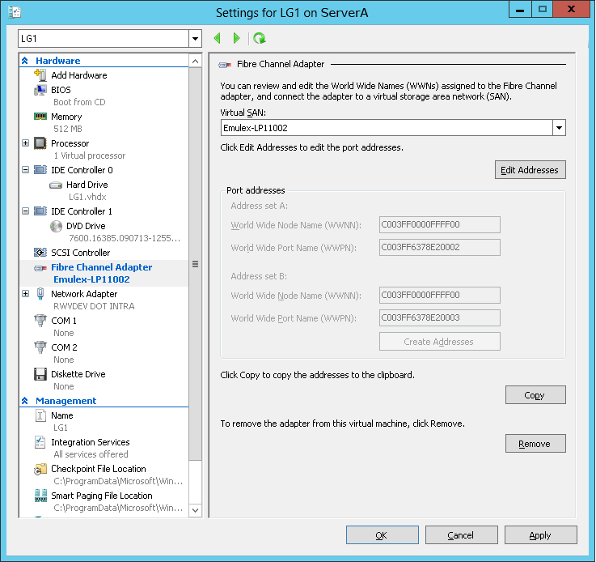
Fig: A Fibre Channel adapter in a VM

